Slide 1
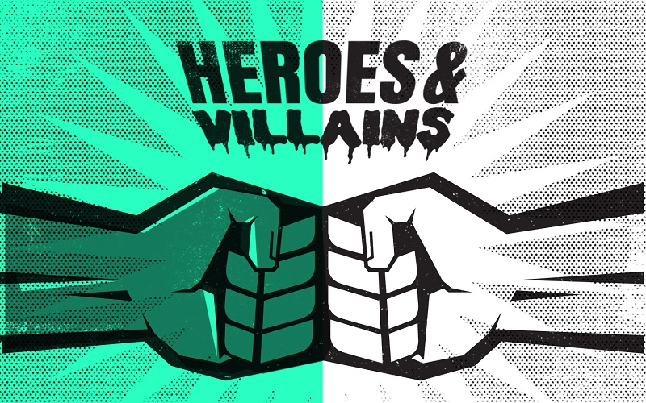

Slide 2
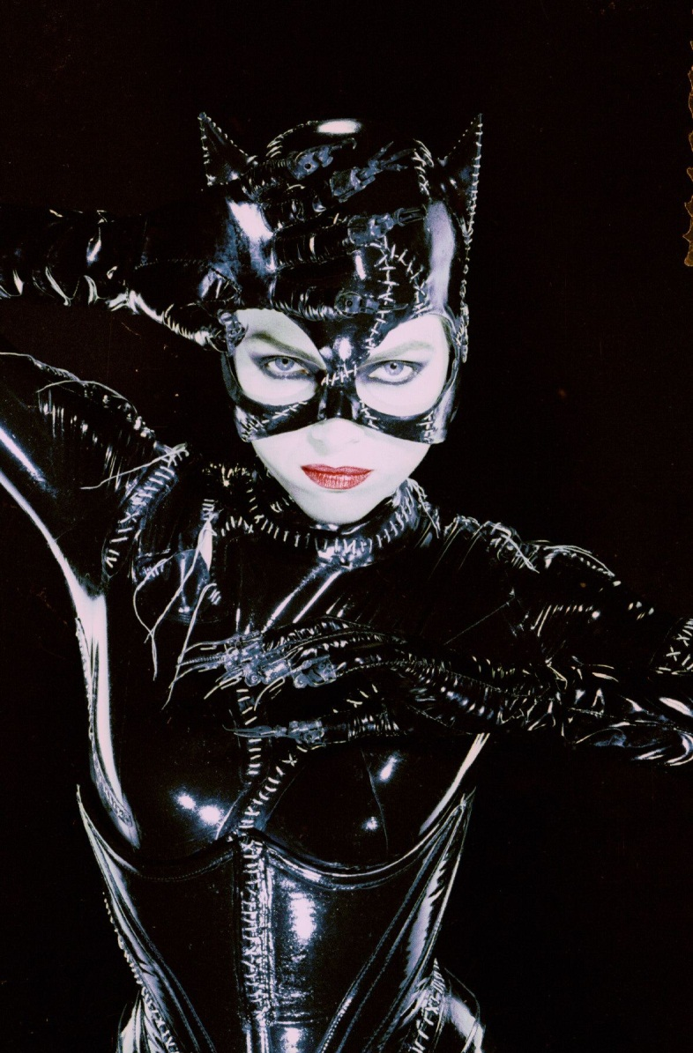
Catwoman
Catwoman, from Batman, is my favourite villain. She has got blond hair, pale skin and green eyes. She wears a black latex suit and a mask. She’s very flexible and she can jump from one building to another, her abilities are very similar to a cat. I like Catwoman because she starts being a very shy woman who became evil because her boss killed her, and many cats resurrected her, giving her felines’ abilities and nine lives.

Slide 3
Who’s your favourite hero or villain?
Read the description of Catwoman.
Think about your favourite hero or villain.
Write a description about your hero or villain following the description of Catwoman and using some of the words from the vocabulary list.
Send your descriptions to your teacher’s e-mail.

